Slide 1

Integrated Emergency Response Drone

Slide 2
Group Members
Name | PRN
Adarsh Halake | 240840143001
Ishwari Helgand | 240840143004
Raj Kamal Patnaik | 240840143007
Vyankatesh Salunkhe | 240840143008

Slide 3
Content
Introduction
Problem Statement
Design & Assembly
Calculations
Working
Conclusion

Slide 4
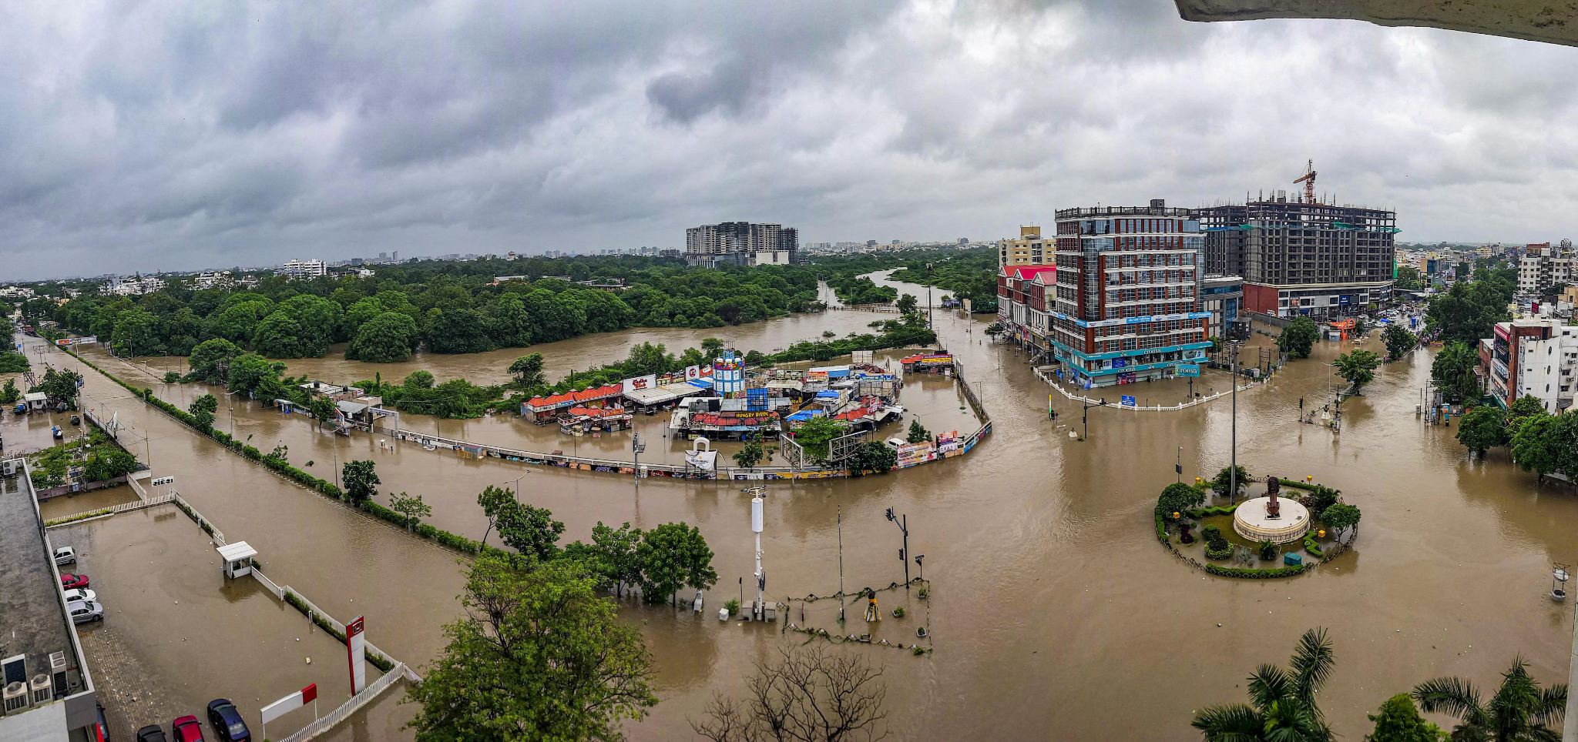
Introduction
Floods often disrupt transportation and make it difficult to deliver essential supplies to affected areas.
With advancements in Unmanned Aerial Vehicles (UAVs), drones have emerged as a promising solution for rapid and efficient disaster response.

Slide 5
Problem Statement
Floods cause severe disruptions, making it difficult for relief teams to reach affected areas.
Traditional relief methods (boats, helicopters) are slow, expensive, and risky.

Slide 6
Solution
A hexacopter drone capable of delivering relief materials to stranded victims

Slide 7
Objectives
Develop an hexacopter drone for delivering payloads.
Enable precise payload drop at predefined GPS coordinates.

Slide 8
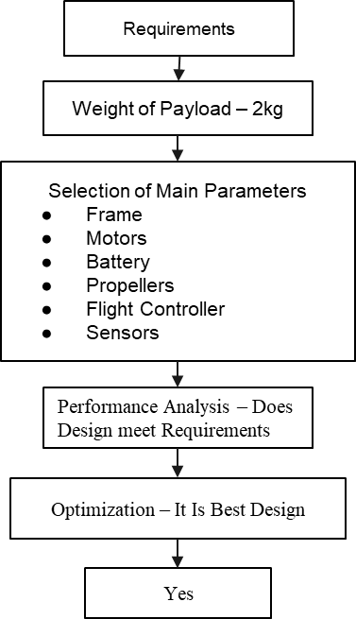
Design

Slide 9
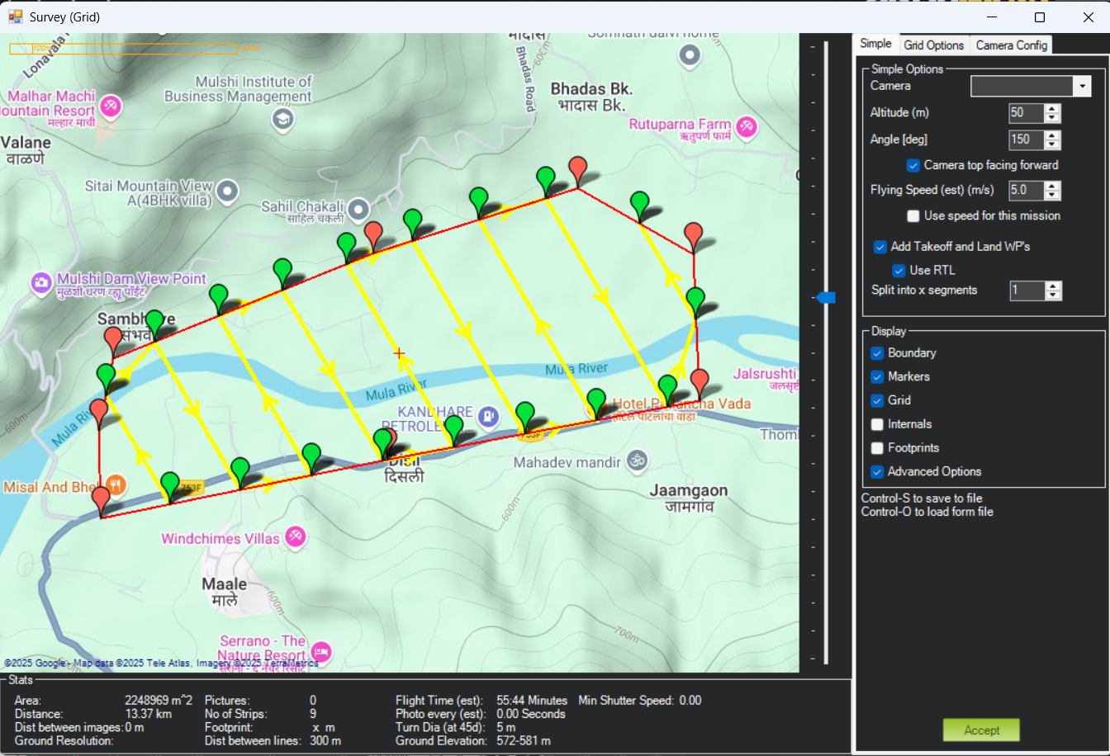
Mission
Area - 550 Acre
Total Distance - 13.37 KM

Slide 10
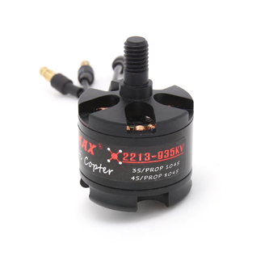
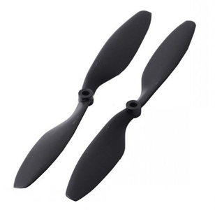
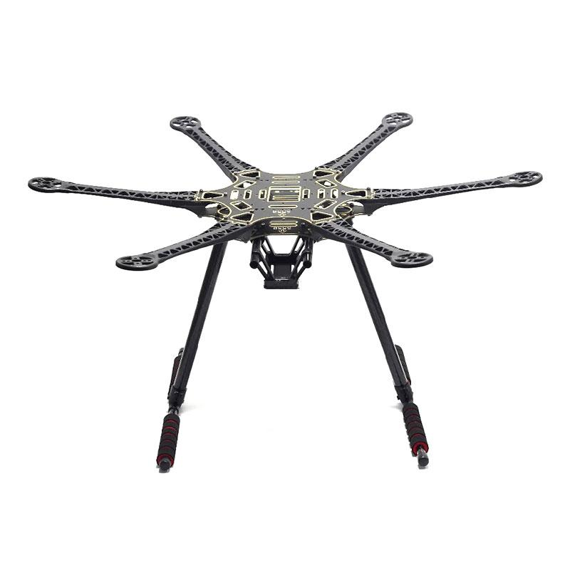
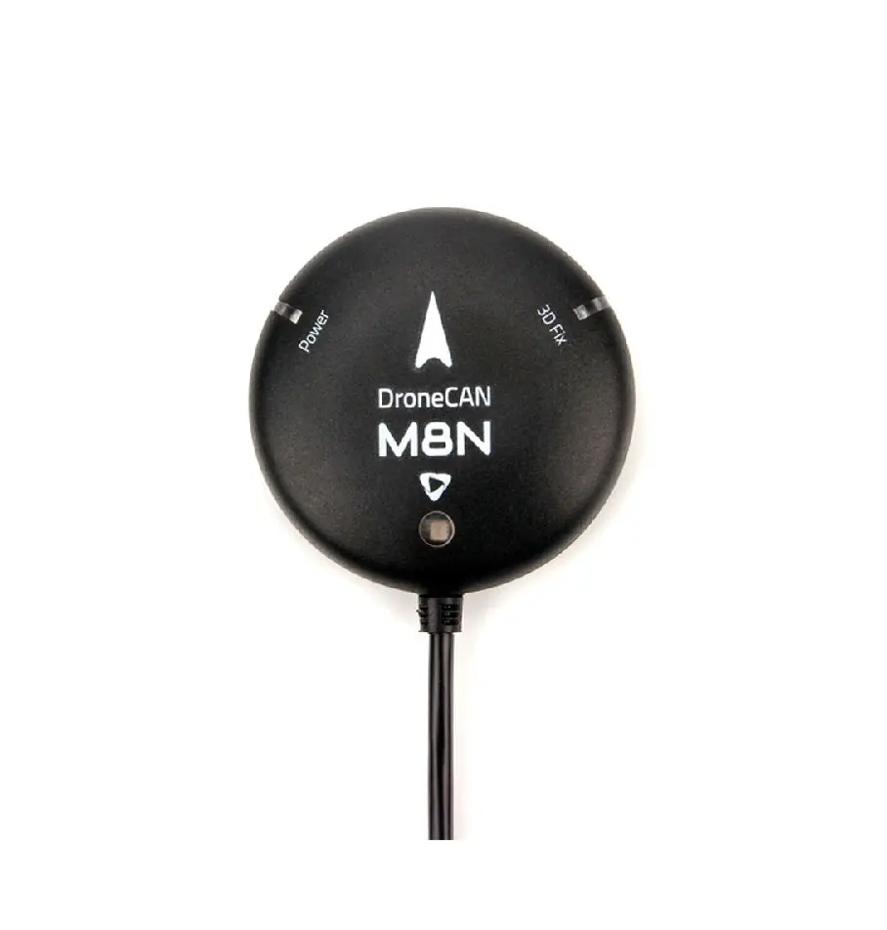
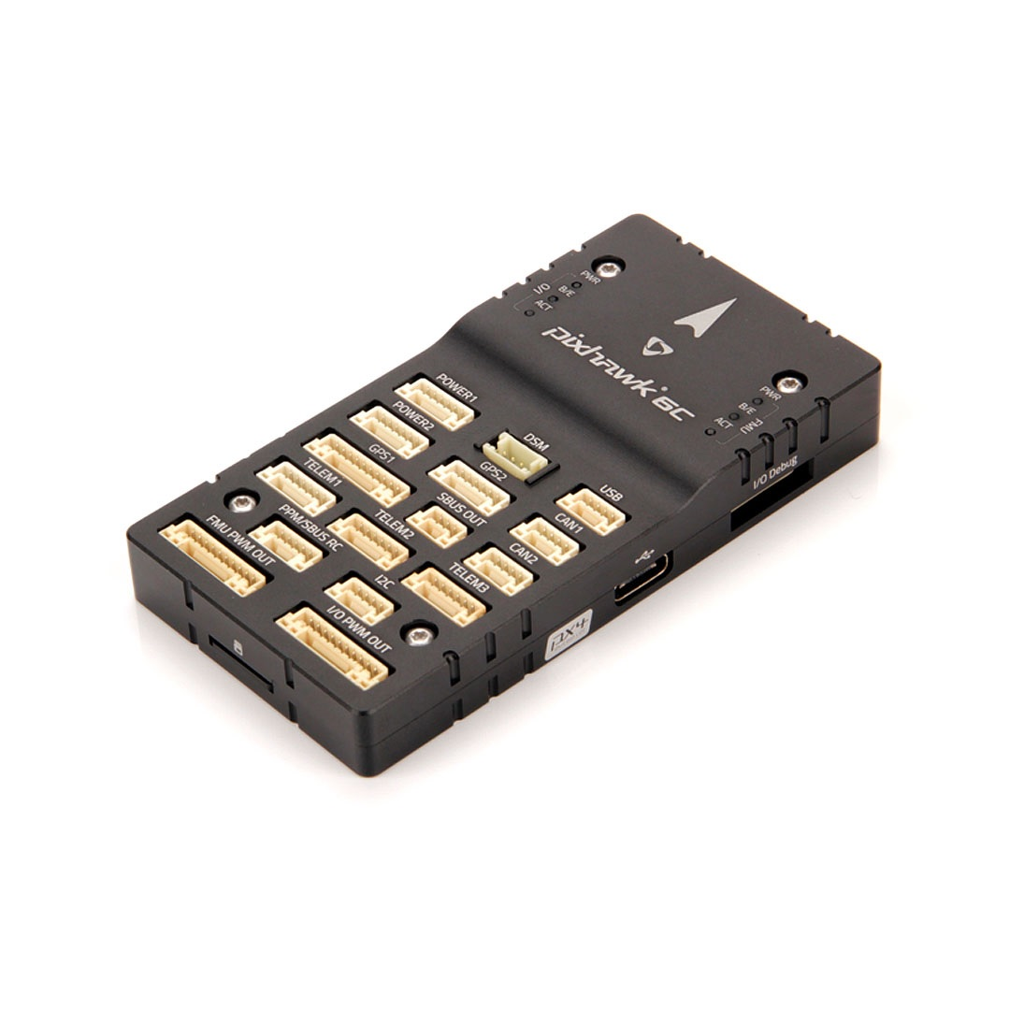
Hardware
10 45
EMAX 2213
550 mm Frame
Pixhawk 6c
M8N

Slide 11
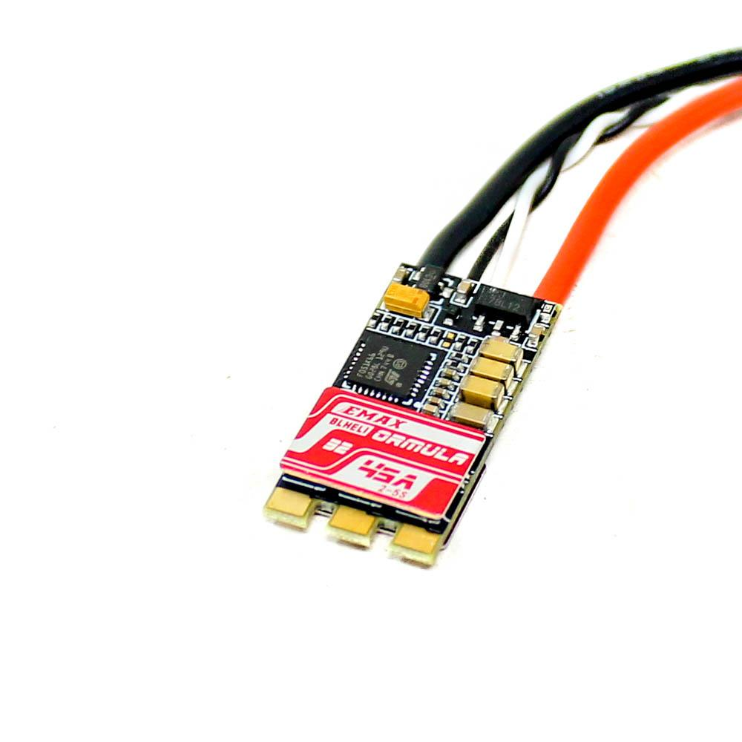
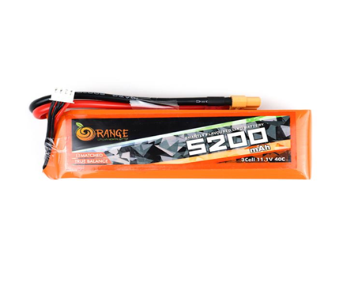
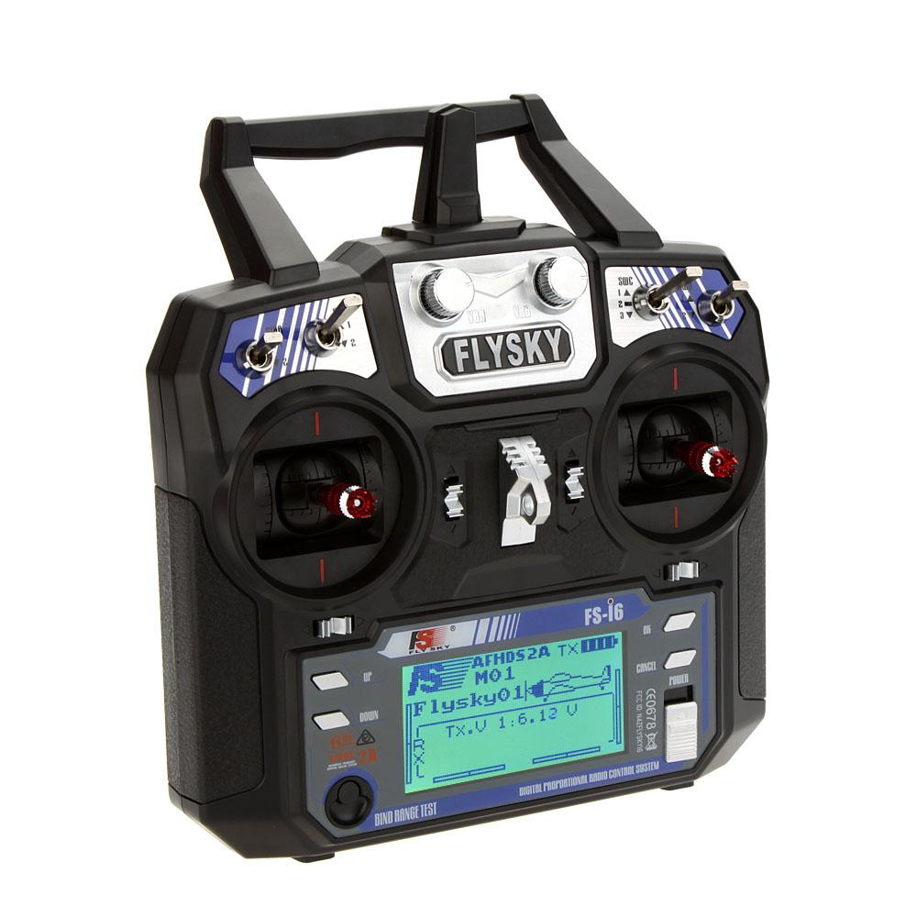
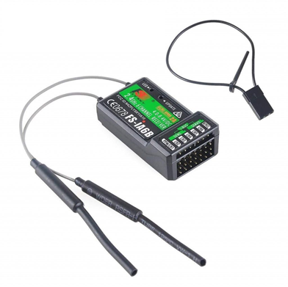
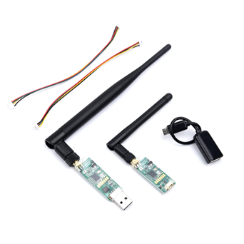
Hardware
ESC
5200 mAh
Transmitter
Receiver
Telemetry

Slide 12
Weight Calculations
Component | Weight (grams)
Drone (without battery) | 1300
Battery | 400
Total Thrust at 50% | 2580
Payload | 880

Slide 13
Endurance & Range
Total Power Consumption - 330 W
Battery provides - 57.2 W
At 75% - 42.9 W
Endurance - 8 minutes
Half Range - 2 KM

Slide 14
Assembly of Drone
Assemble the Frame
Mount Power Distribution Board
Install Motors
Attach Electronic Speed Controllers (ESCs)
Mount the flight controller & GPS
Wire the Flight Controller:
Install Propellers:
Attach Battery and Other Accessories
Check Connections and Calibrate

Slide 15
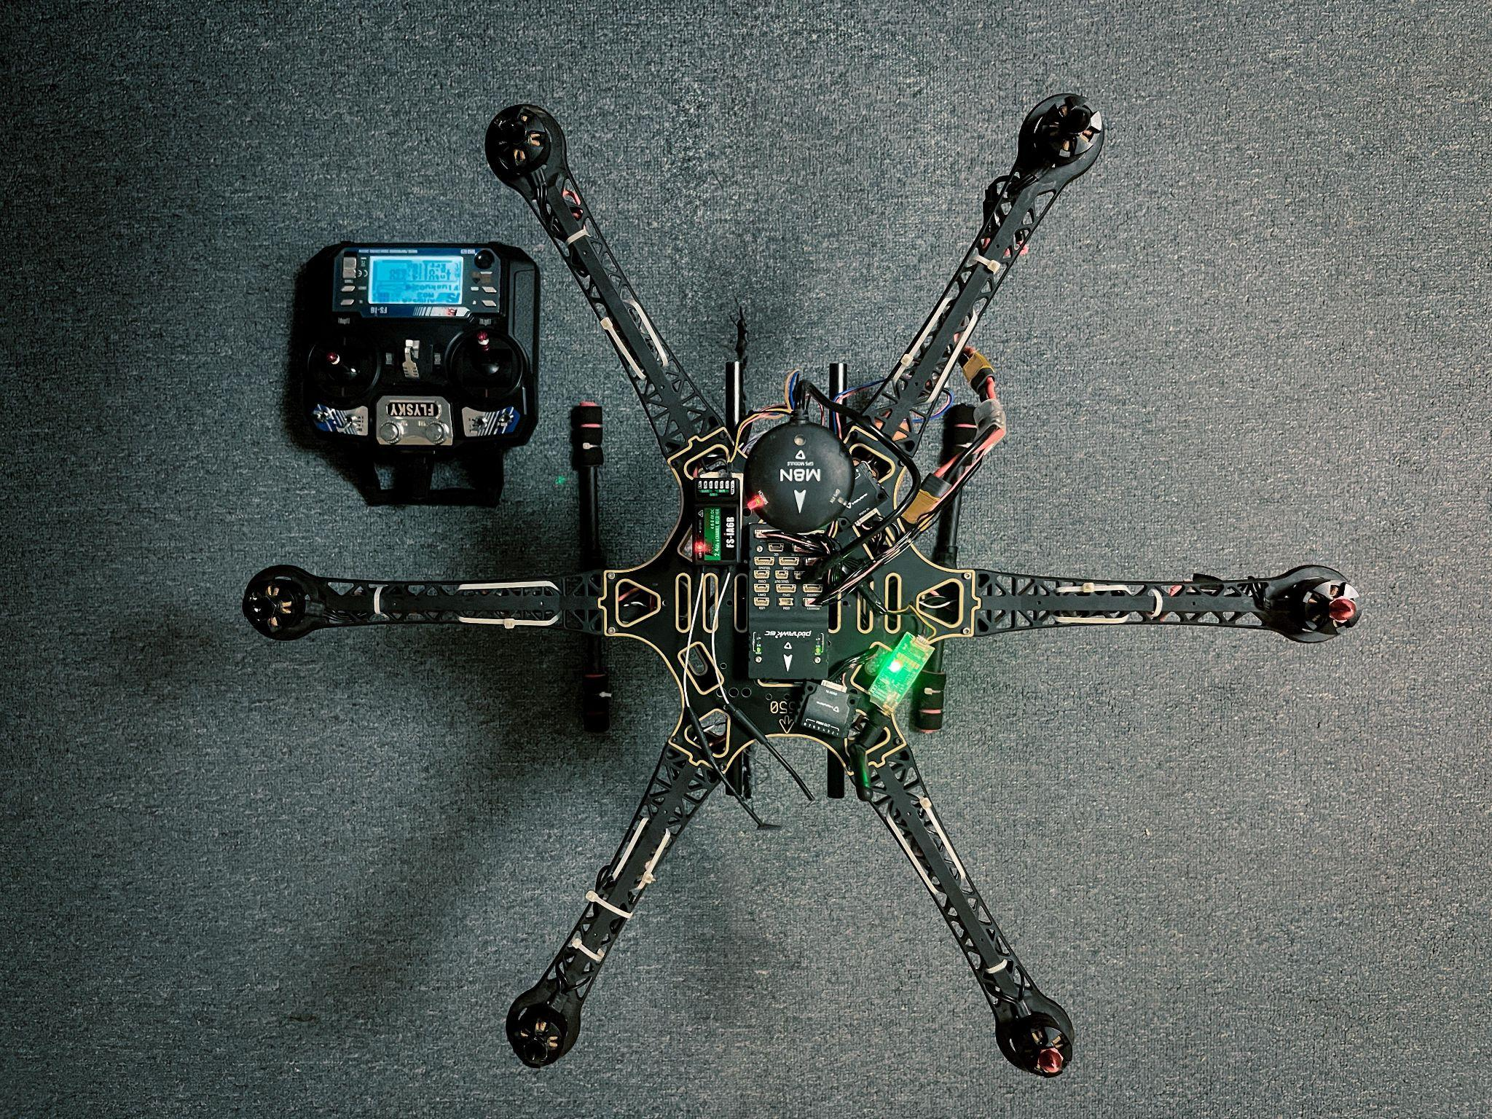

Slide 16
Calibration of Drone
Calibrating the Accelerometer
Calibrating the Compass
Calibrating the ESC.
Calibrating the Radio (RC Controller)

Slide 17
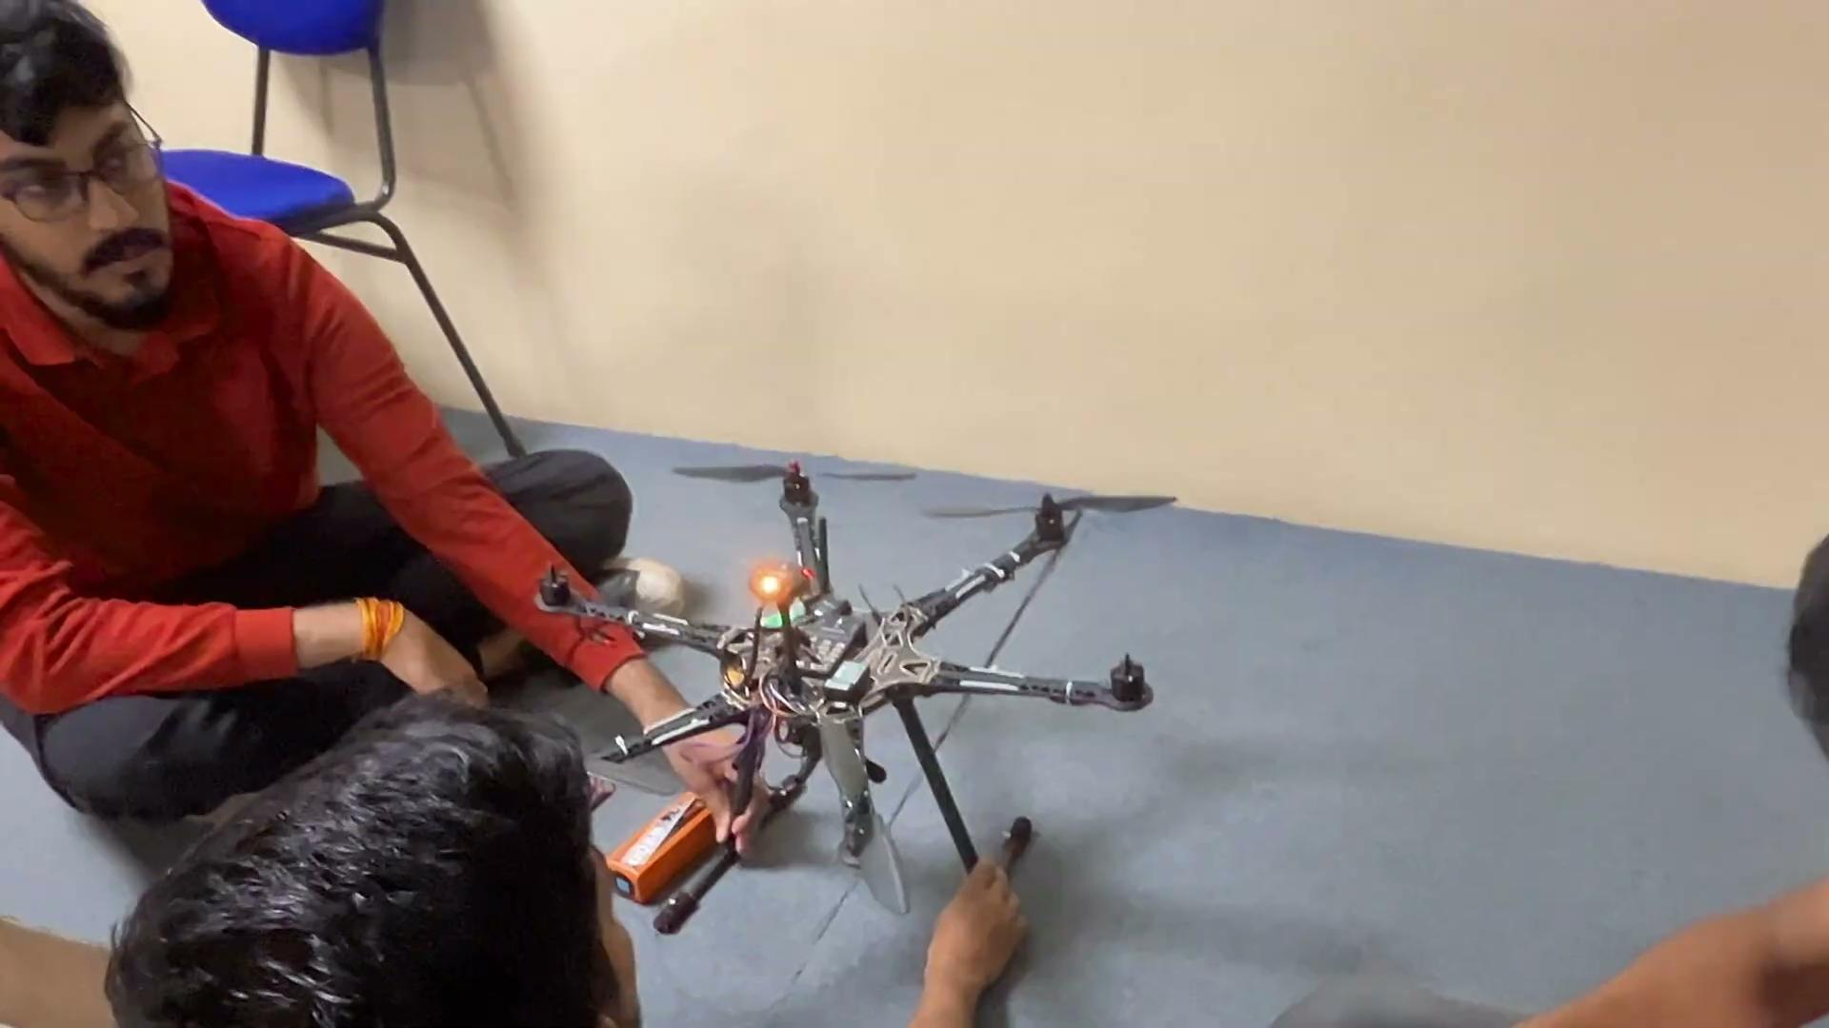
Working Video

Slide 18

Working Video

Slide 19
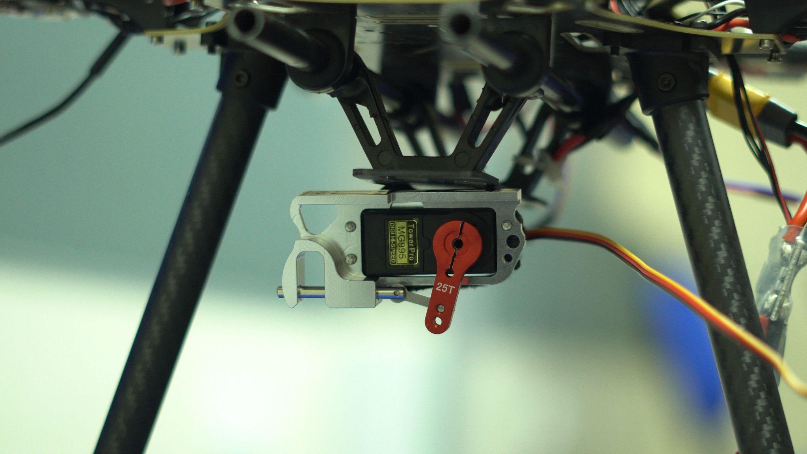
Payload Release Mechanism
The payload release mechanism in this project uses an MG995 servo motor for precise and reliable delivery of relief materials.
The servo is mounted on the drone’s payload bay, where it controls a latch system to securely hold and release supplies.

Slide 20
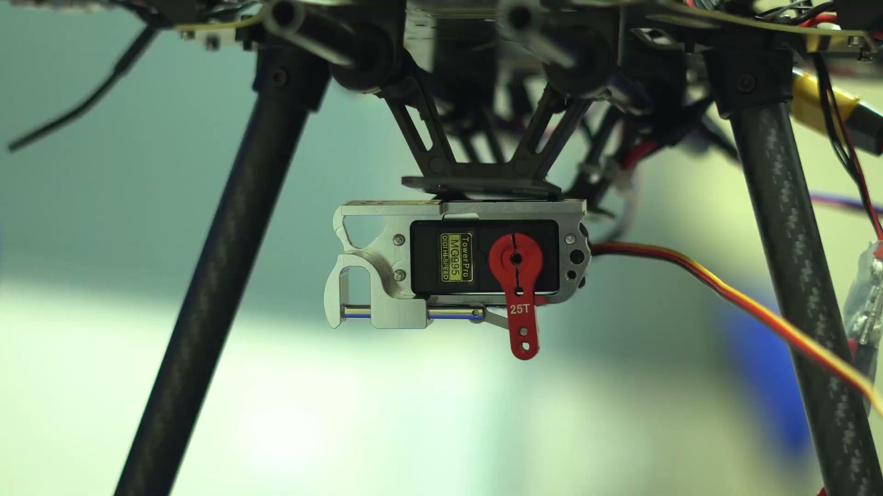
Payload Release Mechanism Working

Slide 21
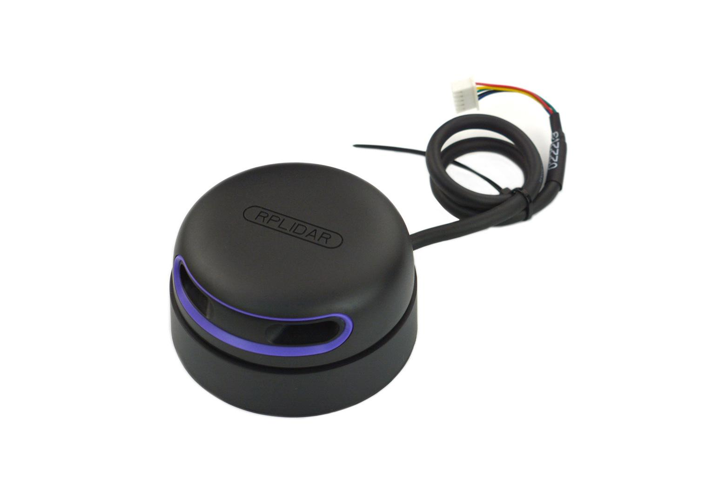
LiDAR
RPLIDAR A2M12 is a 2D laser scanner used for precise distance measurement and mapping, ideal for drone-based applications.
It offers a 360-degree panoramic scan with a range up to 30 meters and can perform up to 16,000 samples per second.

Slide 22
High accuracy (±15 mm) and adjustable rotation speeds (5-20 Hz) make it suitable for detailed survey and structural health monitoring.
Its lightweight design ensures minimal impact on drone flight, and it integrates easily with flight controllers for real-time data acquisition.
Robo Studio platform is used for processing and analyzing the data collected by the RPLIDAR, enhancing the efficiency of survey and mapping tasks.

Slide 23
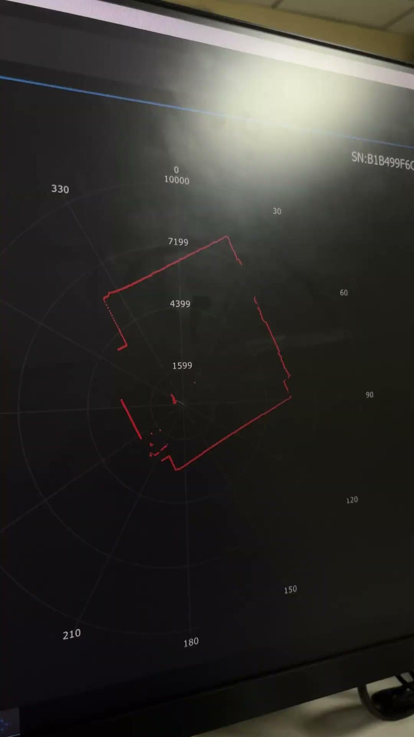
LiDAR Working

Slide 24
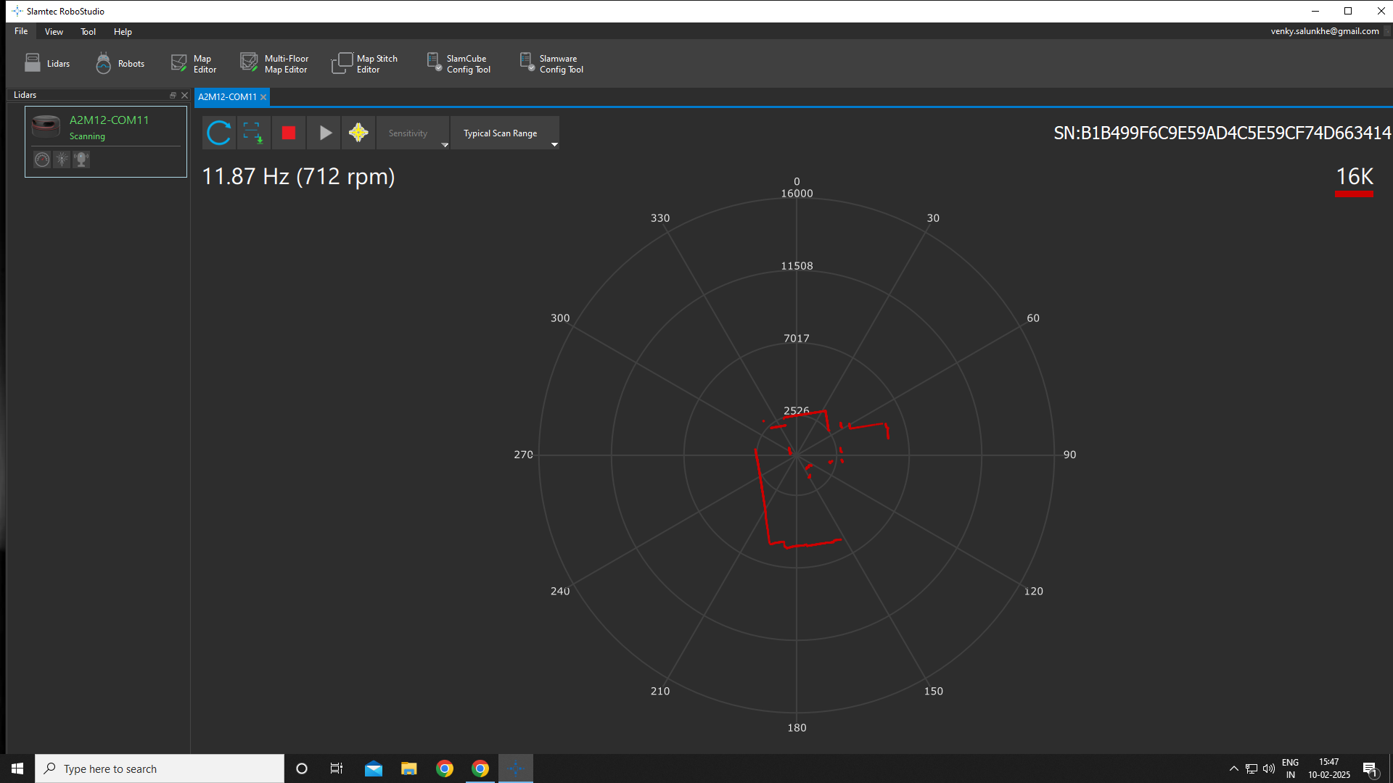
LiDAR Output

Slide 25
Future Scope
Autonomous Path Planning: AI-based route optimization, real-time weather adaptation, and energy-efficient flight.
Smart Payload Delivery: AI-powered drop system, parachute-assisted delivery, and optimized weight balancing.

Slide 26
Conclusion
The hexacopter drone enables efficient and rapid disaster response in flood-hit areas.
The project demonstrates the potential of UAVs in humanitarian aid, reducing reliance on traditional, slower, and riskier relief methods.

Slide 27
Thank You

